Slide 1
Welcome! Solent Junior School Year 3 Curriculum Expectation meeting
Notes:
LW

Slide 2
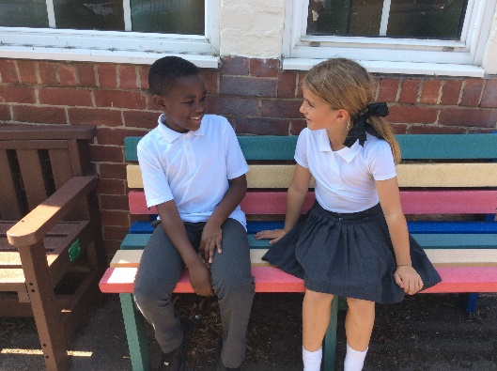
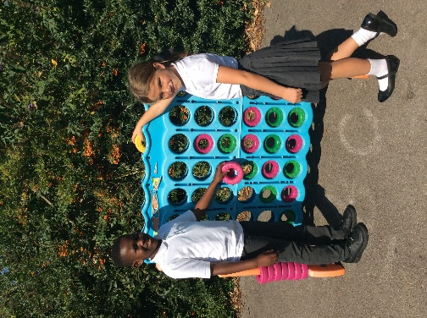
The Solent Schools
Working seamlessly together to ensure every pupil’s journey through the
primary years is as successful and enjoyable as it possibly can be.
Shared staff meetings for both teaching and support staff
Shared inset including joint training and provision
Staff working across the two schools such as Executive Headteacher and
Network Manager
Joint School Improvement Priorities
Tracking for every pupil from Year R to Year 6 – ensuring all pupils make consistently excellent progress throughout
Notes:
LPA

Slide 3
Junior School Jargon Buster!
Key Stage Two (KS2) – Years 3,4,5 &6.
Lower School – Years 3 & 4.
Upper School – Years 5 & 6.
SATs – Statutory Assessment Tests – assessments of pupils in Reading, Writing and Maths, currently taken by pupils in the Summer term of year 2 and 6.
Year 4 Multiplication Testing – A new test introduced for pupils in Year 4.
ELSA – Emotional Literacy Support Assistant.
MFL (Modern Foreign Languages) – Refers to the teaching of languages (French at SJS)
Notes:
LPA

Slide 4
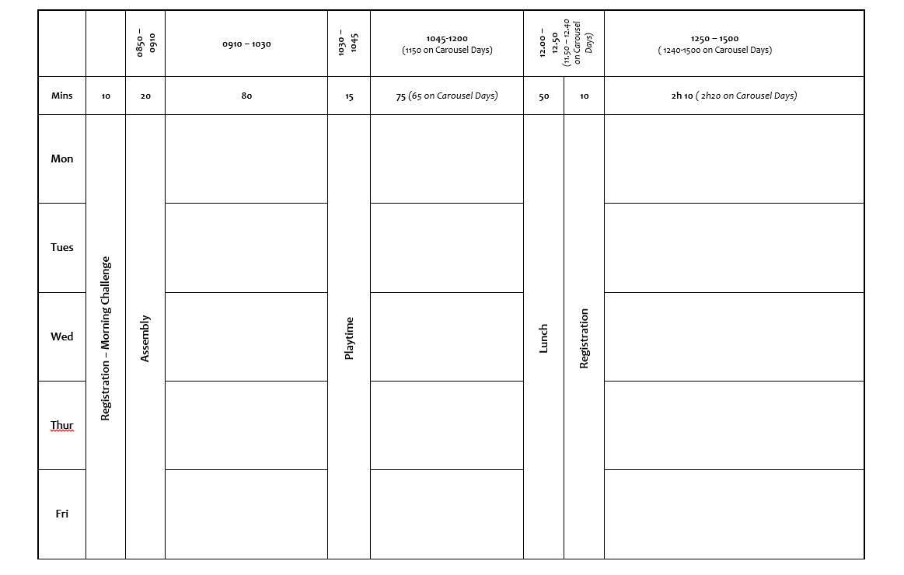
Timetable
Notes:
LPA

Slide 5
Standards/Assessment
Effective handover from the infant school
DC Pro – Formative & Summative
Primary Curriculum
Children are increasingly involved in the assessment process
October, February & Optional July Parent Appointments
Drop in and work share once a term
Progress Reports – 3 times a year
Notes:
LPA

Slide 6
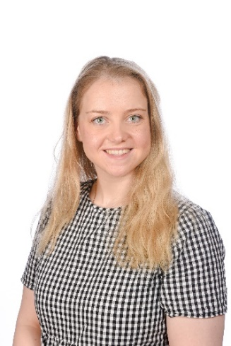
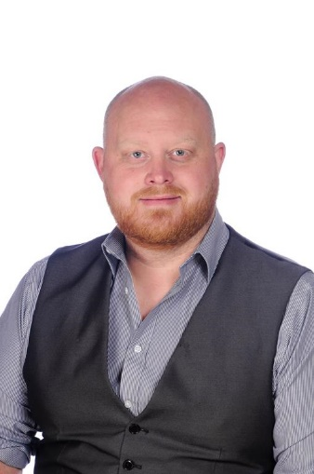
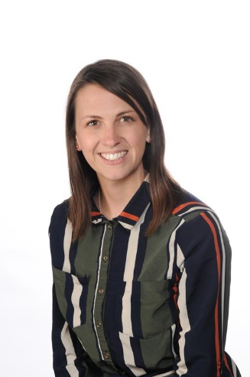
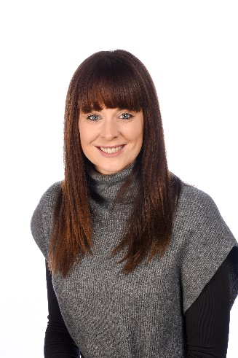
The Year 3 Team
Miss Gall & Miss Atkins (3AG)
Miss Nicholas
(3N)
Mr Mason
(3M)
Class Teacher
First point of contact
Head of School
Executive
Headteacher
Notes:
LPA

Slide 7
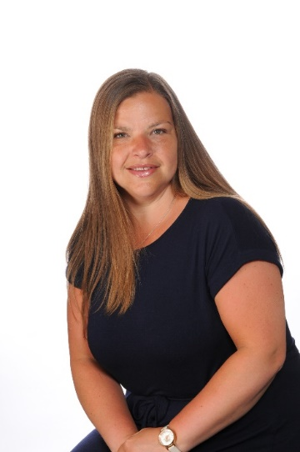
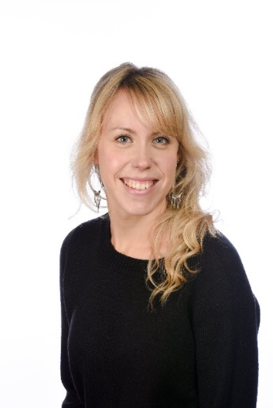
Who’s who and What do they do?
The Pastoral Team
Mrs Herron
Lead LSA
Mrs Witt – ELSA
Lead LSA
Mrs Langford
ELSA
Notes:
LPA

Slide 8
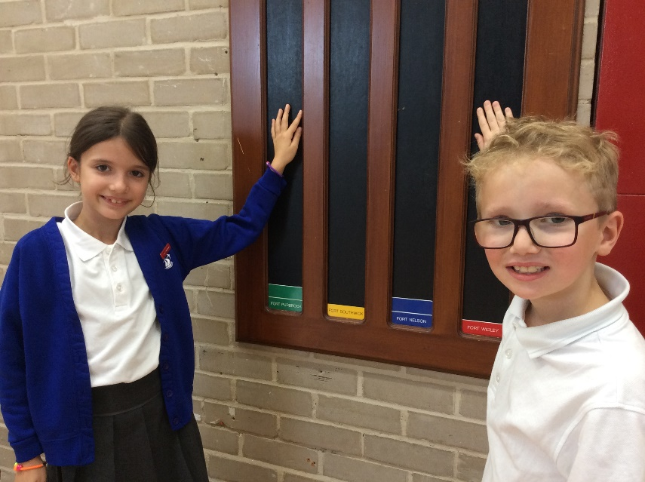
Increasing Responsibility! Value of the month for September
School Council -We have a very active School Council. They have already been voted in and celebrated during assembly this week. They have a different foci each half term.
Eco Warriors & Detectives - A team of pupils from each year group, who champion our environment helping us to remember the contribution we make from our small scale school environment to world wide issues.
JRSOs– A team of pupils who support the school community in promoting walk to school, parking issues and safety around the local area.
Senior Pupil – A team of Year 6 pupils who have demonstrated excellent behaviour and attitude towards learning throughout their time at Solent. They provide great role models to our younger pupils and have a variety of responsibilities in and around school.
Play Pals & Teach Peace Students - Pupils identified as someone to turn to if playtimes aren’t quite going as expected!
House Captains - There are 4 houses; Purbrook, Widley, Nelson and Southwick. Pupils have all been assigned to a house and are rewarded house points for demonstrating a whole range of attributes.
Head Pupils -Each Year a Head Pupils are voted in to be excellent ambassadors of our school
Notes:
LPA

Slide 9
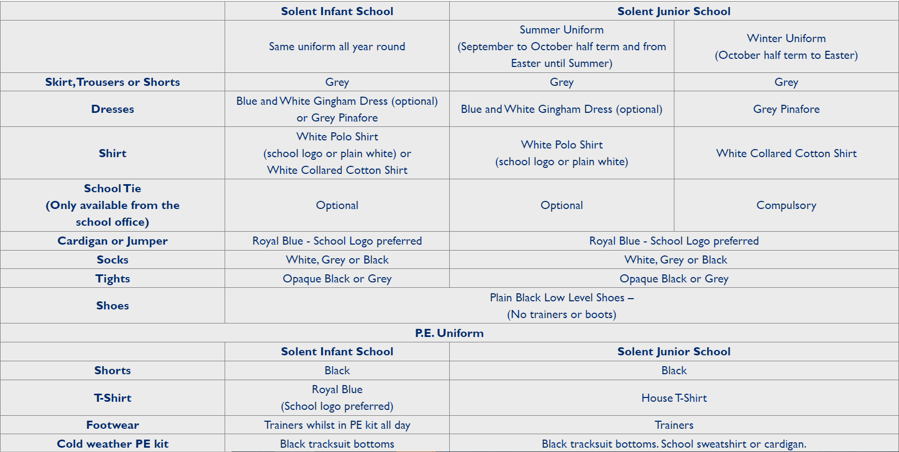
Uniform
Please ensure your child has kit on each of their PE days!
Notes:
LPA

Slide 10
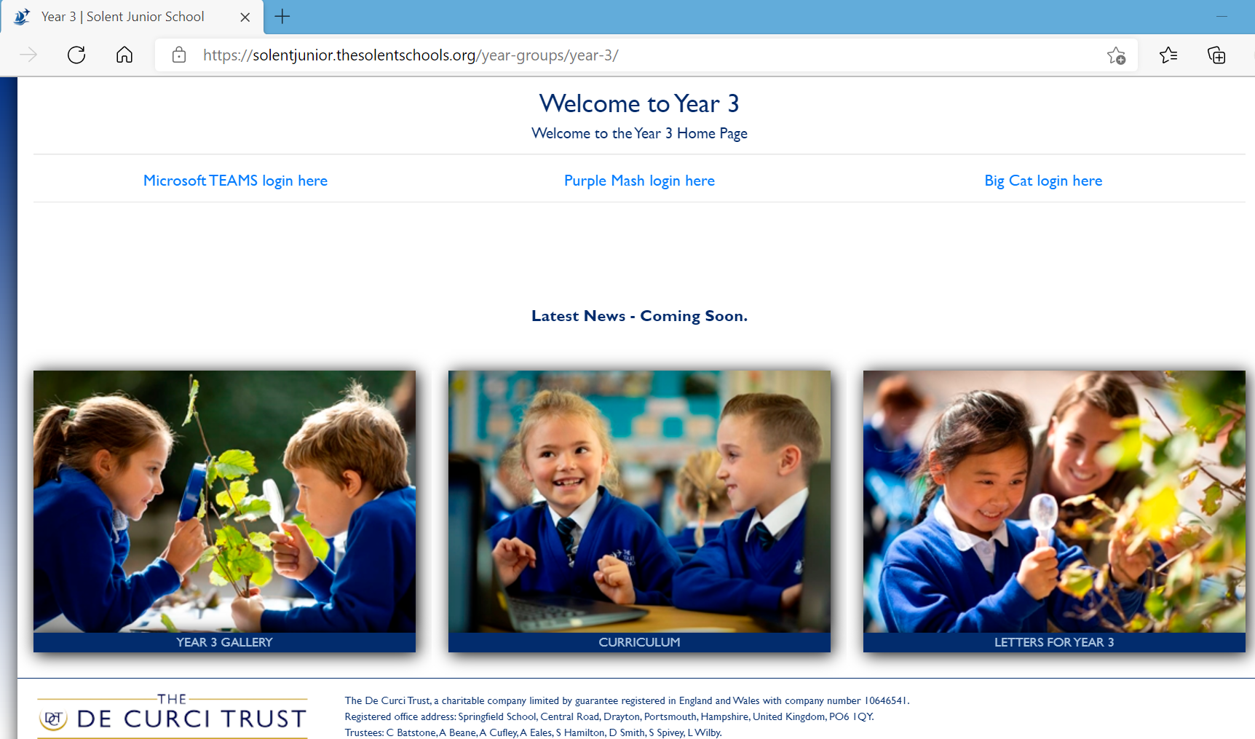
Notes:
Jem

Slide 11
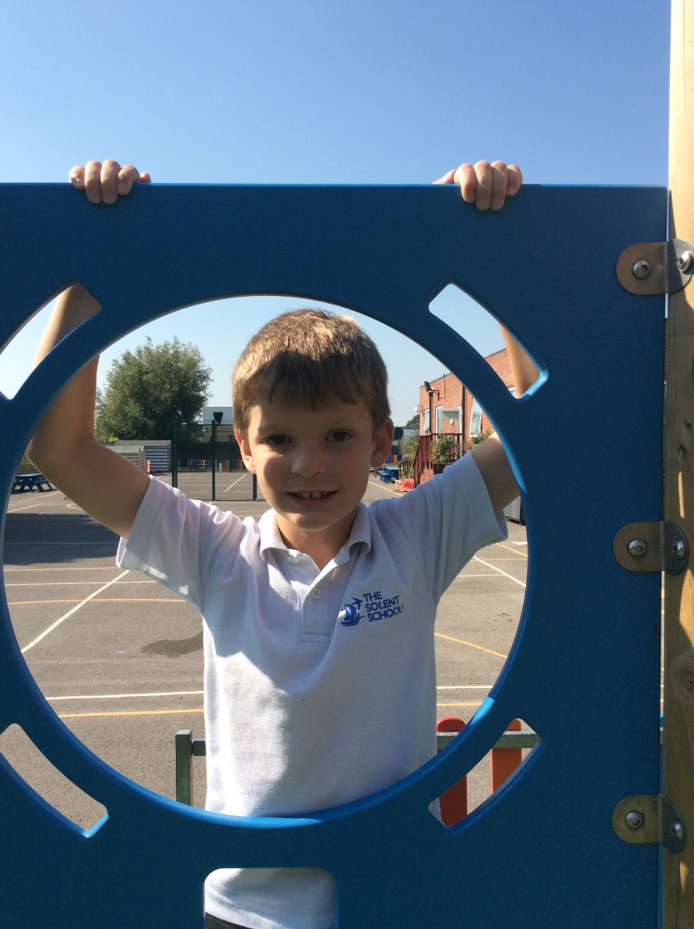
Curriculum Expectations – Year 3
There are many exciting learning opportunities over the year:
Stone Age, Animals and the Ancient Egyptians to name but a couple…
Strong focus on core skills, especially; Spelling, Grammar, Punctuation and Handwriting in English. Place Value, Timestables and Counting in Maths.
Children will be working towards becoming more efficient mathematicians and more accurate writers as well as explorers, inventors and thinkers across the whole curriculum.
Notes:
Jem

Slide 12
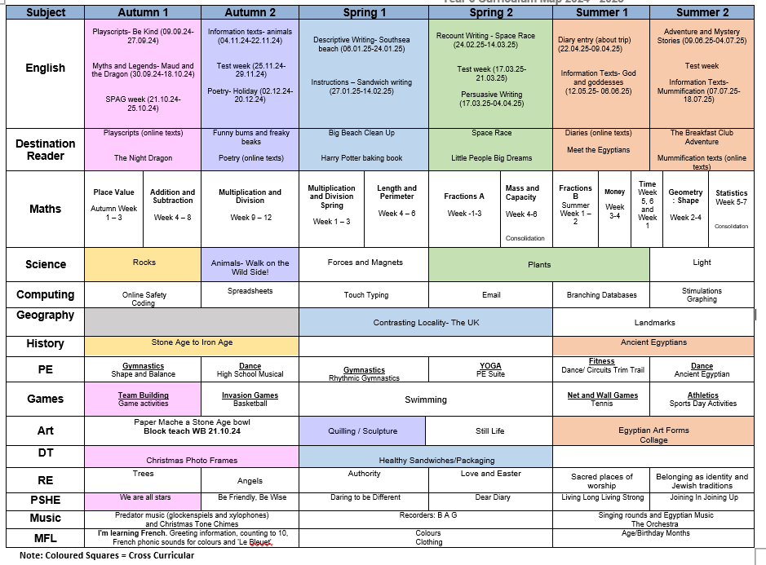
Notes:
Jem

Slide 13
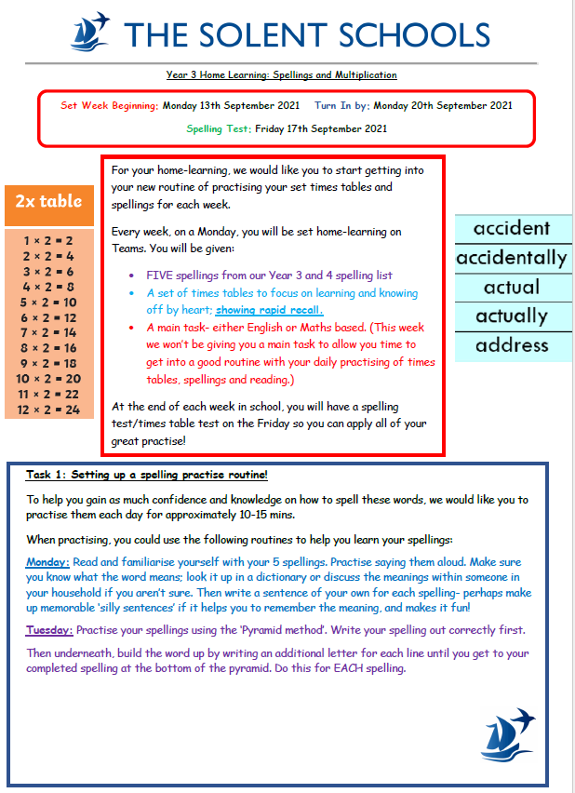
Home Learning – Monday
Home Learning:
Encourages independent learning.
Builds upon learning in school.
Works in partnership with parents and carers.
Consolidates learning from within class.
In Year 3, either a Maths or English home learning activity will be set each week. 30 minutes of time working on the task is enough, unless you want to do more! These will be send home via Teams and returned via Teams.
If you have any issues logging on, please contact the school.
There is a ‘Learning Log’ (creative homework) shared once a term.
We recommend, reading daily with your child and practising their timetables with them at home. These will also be sent home weekly.
The children will also bring home 5 spellings each week to learn from the Y3 and 4 word list – These are also on the school website.
Notes:
Alice

Slide 14
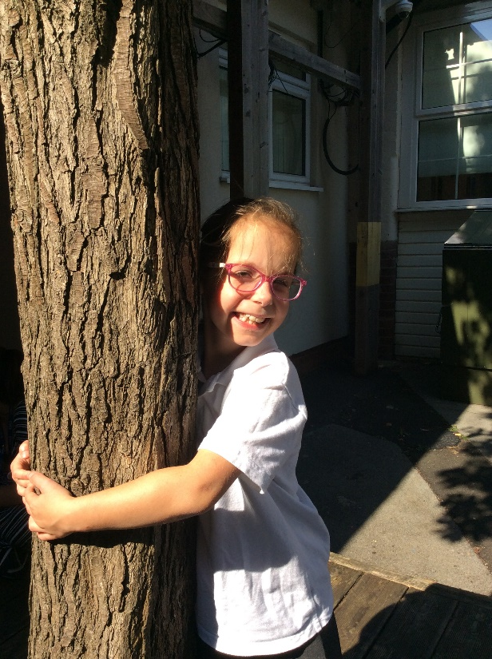
Phonics and Spelling
The children will continue to use their phonics skills within our taught spelling sessions in Year 3 and begin to learn new spelling patterns and strategies for spelling more complex words and techniques for words where phonics cannot be solely relied upon.
Currently we use the Spelling Shed scheme by Ed Shed as well as Little Wandle reading and phonics scheme.
Spelling takes place daily in class where both the statutory words for Year 3 and 4 will be learnt alongside the taught spelling strategies for homophones, suffixes and prefixes etc. It is therefore really helpful to continue to learn the spellings in the weekly homework as it gives the children the extra opportunity to consolidate what we do in school.
The children learn spellings in really new and exciting ways so please ask your children to show you some on the skills they use when learning spellings!
Notes:
Alice

Slide 15
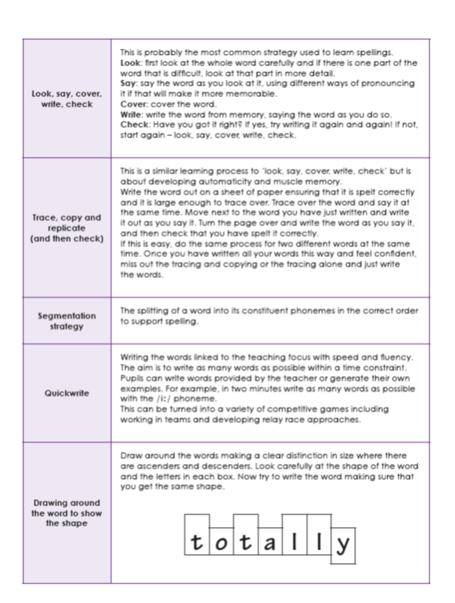
Look, say, cover, write, check
Drawing an image around the word
Pyramid Words
Spelling
Rainbow Writing
Clapping the syllables in a word.
Notes:
Alice

Slide 16
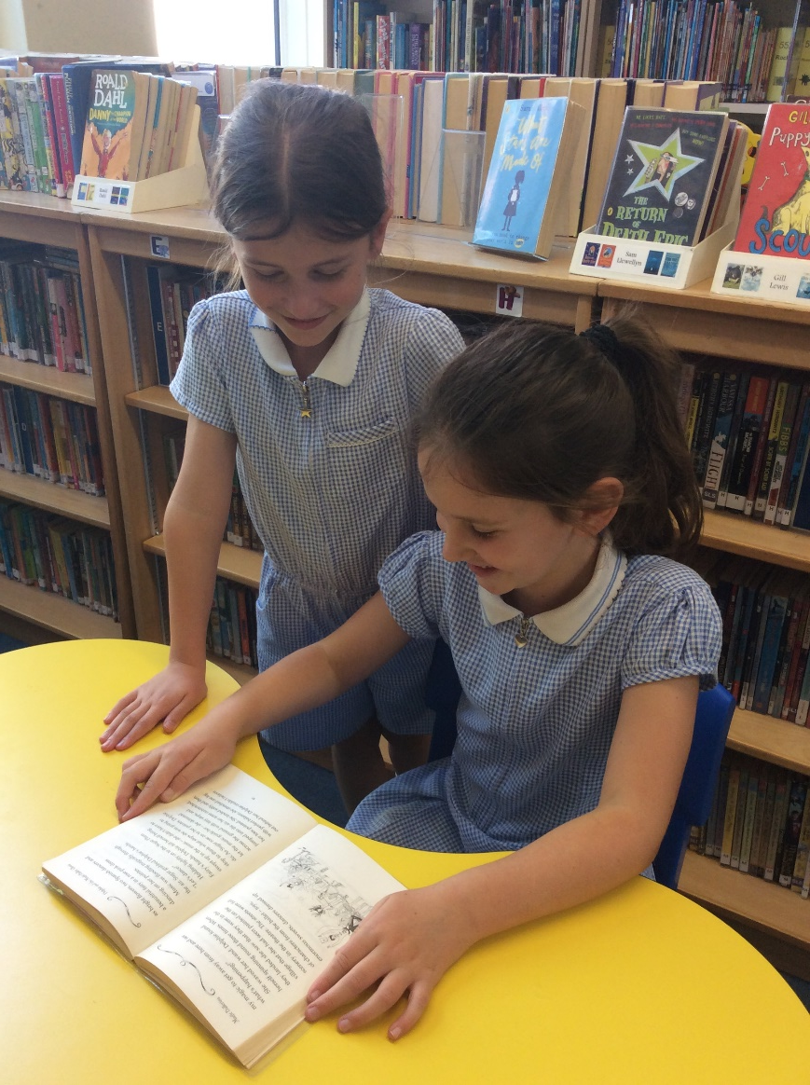
Reading
In Y3, the children develop their independence as readers, choosing books they would like to read at an appropriate level of challenge.
Each class will visit the Library each week on a Friday and can bring two books home at any time.
Please encourage the children to read widely and as often as possible.
Notes:
Lucy

Slide 17
Maths
Plus KIRF sessions 3 times per week for 10 minutes (Key Instant Recall Facts)
Notes:
Lucy

Slide 18
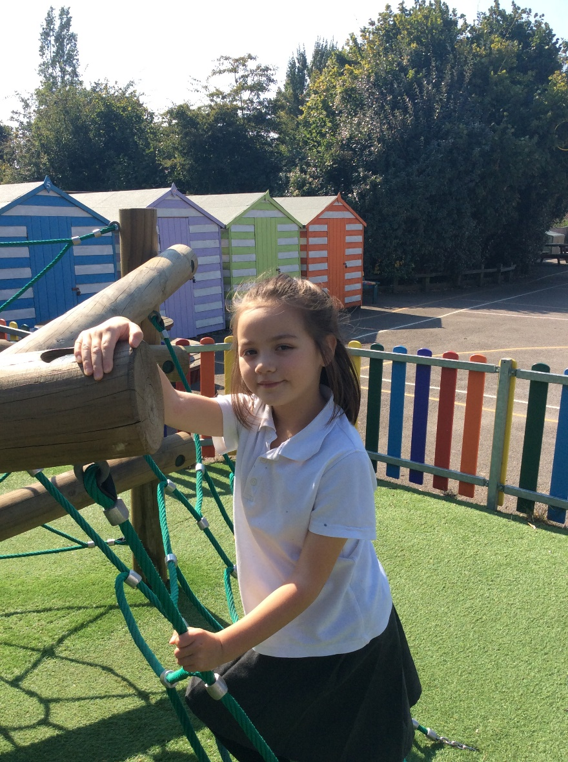
Interventions
Regular interventions take place over the course of the week.
These will include weekly Maths, Reading, Spelling and Little Wandle interventions.
Will be supplemented by extra support with handwriting grammar and/or editing from the class teacher.
Intervention groups are flexible and are often responsive of needs on that day. Groups are not fixed and are designed to support any gaps or misconceptions as the arise – it could be your child needs a quick top up one day and not the next.
Notes:
Jem

Slide 19
Useful Websites
Times Table Rock Stars (TTRS)
www.ttrockstars.com https://ebooks.collinsopenpage.com/
Great links for SPELLING games!
https://spellingframe.co.uk/
https://spellingshed.com
http://www.ictgames.com/mobilePage/spookySpellings/index.html
http://www.ictgames.com/mobilePage/lcwc/index.html
https://www.arcademics.com/games/coconuts
Useful Links and Multiplication Games:
https://www.topmarks.co.uk/maths-games/7-11-years/multiplication-and-division
https://www.timestables.co.uk/games/
https://www.topmarks.co.uk/maths-games/daily10
Notes:
Alice

Slide 20
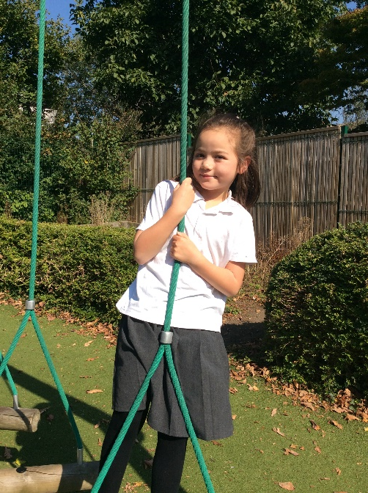
Teams and School Website
Teams will be used for updates and notices so keep an eye out for notifications as this will be the quickest way to be kept up-to-date. Check it daily just in case we have added any notices.
Assignments will be available on Teams for weekly Home Learning on a Monday. A new assignment will be available each Monday so please ensure you have upload the completed home learning by the deadline set – there is no need to print anything off or hand work to the teacher. It will all be done on Teams.
Please visit the school website and click on the Year 3 page for year group letters, updates, useful links, curriculum news and our gallery
Notes:
Jem

Slide 21
Organisation
Notes:
Lucy

Slide 22
Dates for your Diaries:
Year 3 Nativity: Tuesday 17th & Wednesday 18th December 2024 (TBC)
Swimming: Wednesday 15th January 2025- 28th March 2025
Sandwich Making: Monday 3rd February 2025 (TBC)
Rainbow Rave: Friday 25th April 2025 (TBC)
Portsdown Hill Thursday 1st May 2025 (TBC)
Egyptian Dress Up: Thursday 17th July 2025 (TBC)
Egyptian Drop In: Friday 18th July 2025 (TBC)
Notes:
Alice

Slide 24
Any Queries or Questions Please email year3@thesolentschools.org or contact the school office. Thank you for attending!

