Slide 1

Welcome!
Solent Junior School New Parent & Carer Meeting 2025
June 2025

Slide 2


Contact Points
First point of contact with a class based query, should always be the Class Teacher. At Solent Junior School, the class teachers are available daily after school as they stand on the external classroom door that faces onto the playground.
Alternatively, class teachers can be contacted via the ‘contact us’ tab on the school website.
If you are visiting site, you can also leave a message with the school office for any member of staff. They are outside the main door taking messages both in the morning and afternoon at school collection time.
Class Teacher
& Learning Support Assistant
Executive Headteacher
Mrs Wilby
Head of School
Mrs Peterkin-Aldred

Slide 3
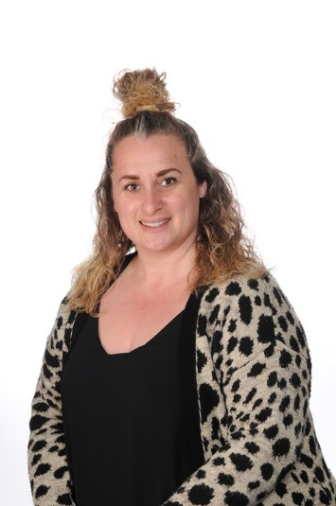
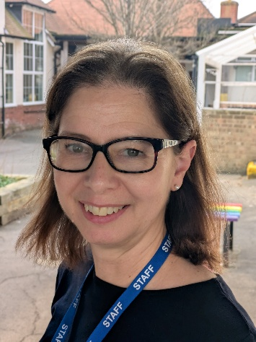
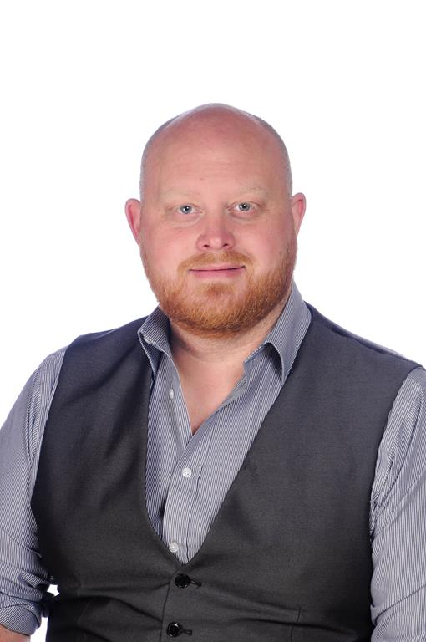
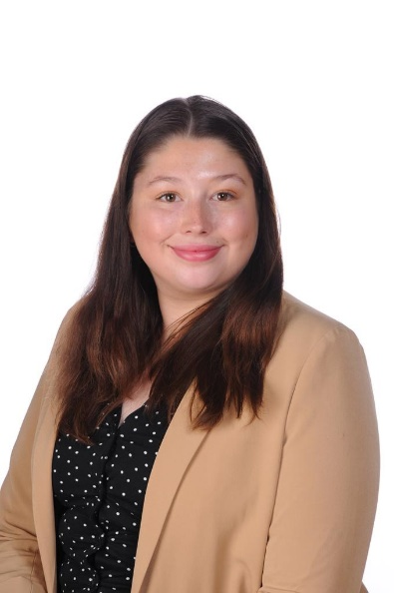
Who’s Who
Year 3 Teaching & Learning Team
Miss Hill & Mrs Dodds
(3DH)
Miss Parsons
(3P)
Mr Mason
(3M)

Slide 4
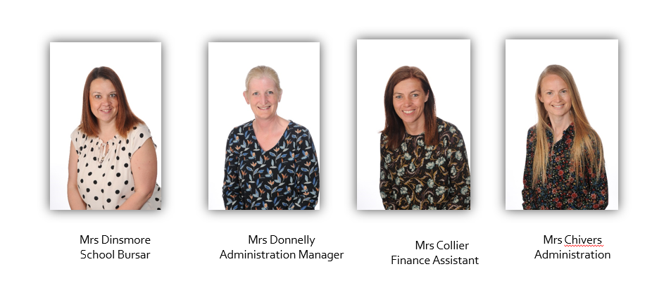
Communication
We know that the good communication is essential
If you are visiting school for a meeting, please always enter the school building via the office, so that we are able to sign you in and out of the building, even if it is for 5 minutes. This is the same entrance that you have used today.
The Office Team

Slide 5
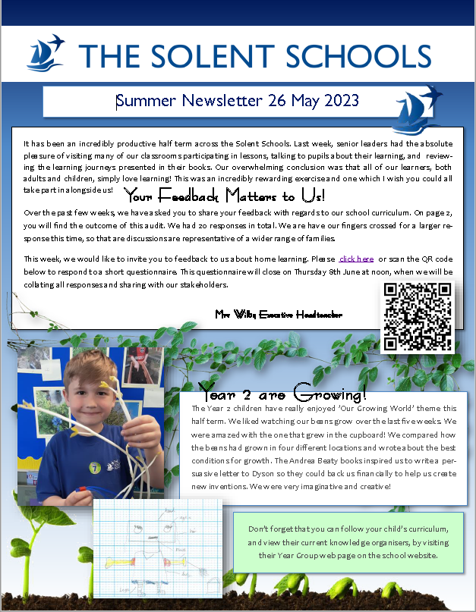

Communication
We know that the good communication is essential
If you are visiting school for a meeting, please always enter the school building via the office, so that we are able to sign you in and out of the building, even if it is for 5 minutes. This is the same entrance that you have used today.
Newsletter
Our school newsletter is normally issued weekly. It is the best place for keeping up to date with everything that is going on across the two schools. The dates list on the back page is updated weekly. A dates list for 2024/2025 will be included in the edition coming home before the end of term! This is also available via the school website.

Slide 6

Communication
We know that the good communication is essential
Social Media – Always look for the logo!
Follow our TSS Instagram page or
Like the SJS page on Facebook!

Slide 7
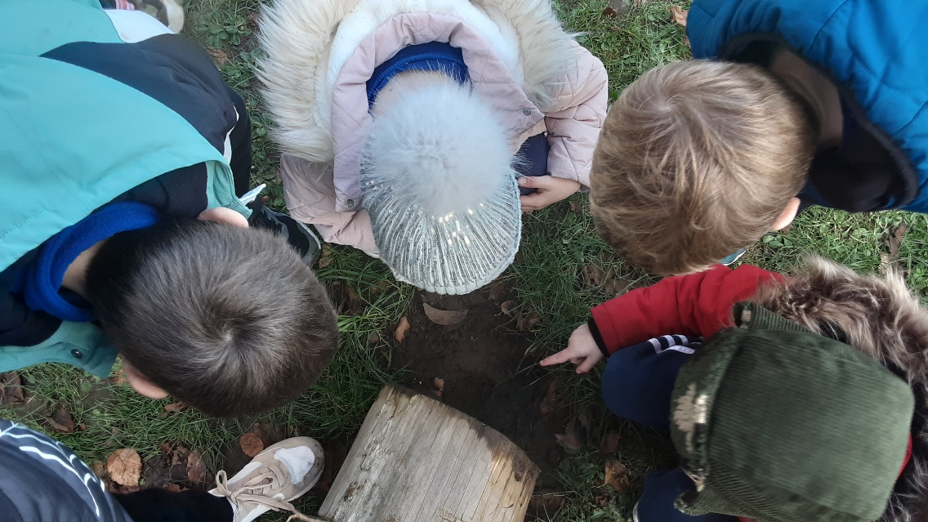
Transition
The Solent Schools – Shared Approach.
Wednesday 4th June – Open Afternoon.
Buddy Activities – Year 2 and Year 5 (June & July).
Transition Days – Activities will be flexible in line with the roadmap (they are set for 30th June & 1st July).
Year 3 transition talks with Year 2 – additional provision (ELSA).
There is a lot of information on the school website that you could share with your child throughout the lead up to their move.

Slide 8
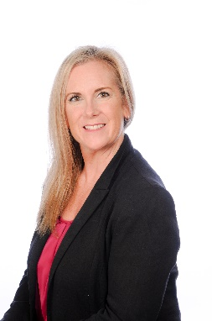
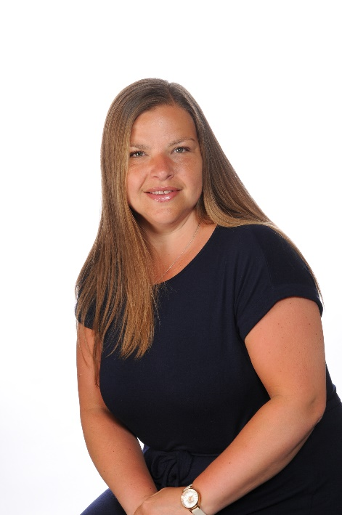
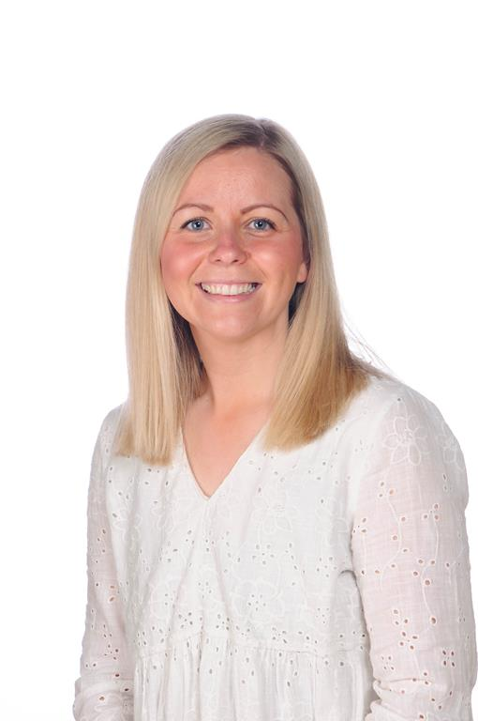
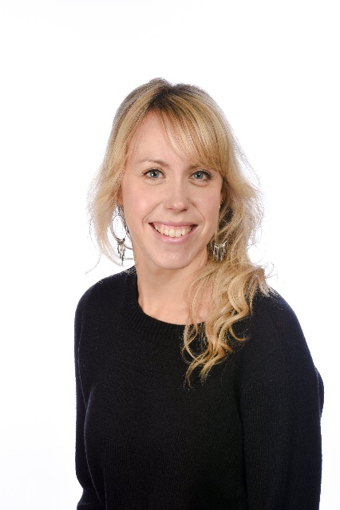
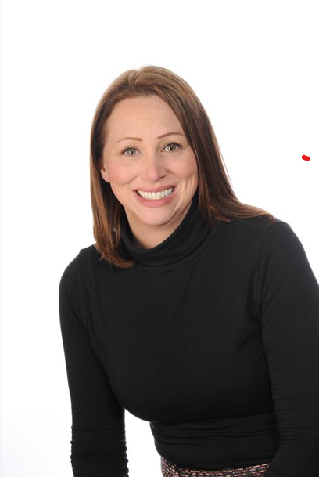
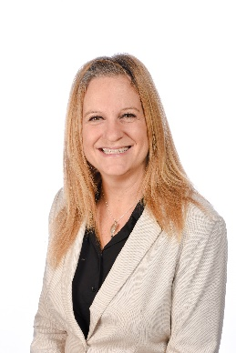
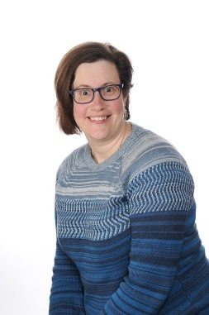
Who’s Who
The Pastoral Team
Designated Safeguarding Lead
Mrs Peterkin-Aldred
Deputy Designated
Safeguarding Leads
Mrs Wilby Miss Smith
Mrs McQuilken
Sendco
(Deputy Designated
Safeguarding Lead)
Mrs Langford
ELSA
Mrs Witt
ELSA
Lead LSA
Mrs Herron
Lead LSA
Inclusion

Slide 9
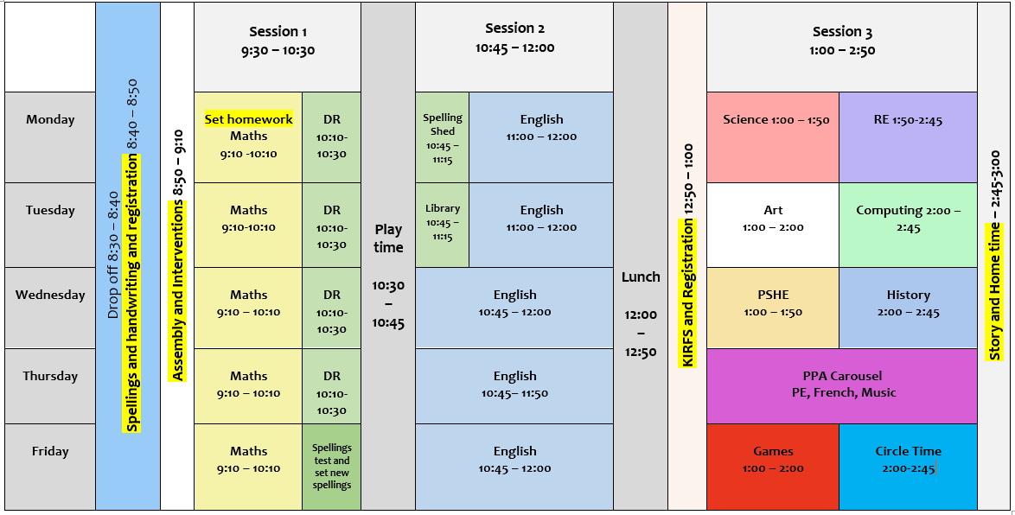
Timetable
In the morning gates open at 8.25am and close at 8.40am.
In the afternoon gates open at 2.50pm and school finishes at 3pm.
Lower school entrance and exit is via the car park pedestrian gate (East entrance).
Upper school entrance and exit is via the main office gate (West entrance).
Year 3 & 4 (lower school) pupils can be left at the gate (it is supervised) in the morning, but must be collected by a known adult at the classroom door at the end of the day. They will not be dismissed until a known adult is present.
Year 5 & 6 (upper school) are dismissed independently and their parents and carers wait outside the front of the school on the pavement.

Slide 10
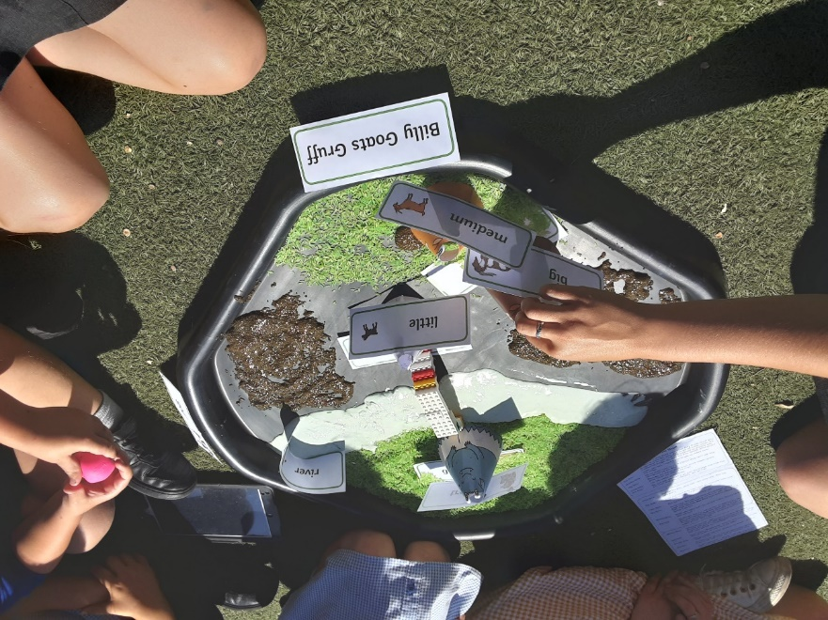
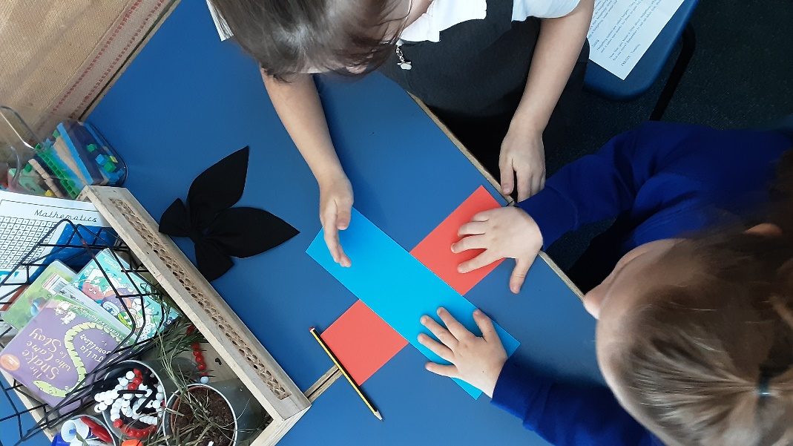
Celebrating Success
Golden Moments
Celebration Assembly - Friday
Team/House Points
Star of the Week – Class based
Golden Child – Golden Assembly
Governors’ Shield
Well done postcards

Slide 11
Student Voice
We have a very active School Council with a school council rep in each class.
Eco Warriors in each class.
JRSOs.
Senior Pupils – Year 6.
Head Pupils.
Play Pals and Teach Peace Pupils.

Slide 12

Uniform
Uniform is available to purchase online via the school website.
There is a Summer and Winter uniform (Information is available on the school website).
PE Kit: –
  Coloured House t shirt, black shorts.
  In Winter – black jogging bottoms, outdoor trainers and school house hoodie in addition to the above.
PE kit can be worn on the days that the class have PE – class teachers will share these days with you in September.

Slide 13

The First Day
School will be open from 8:25 am.
Please enter the site through the main eastern gate (by the car park).
Any children who want to come in through the gates independently in the morning are welcome to do so. There will always be staff stood on the gate for the 10 minutes that they are open in the morning.
Pupils should bring all their bags and coats into class on the first day. The teacher will then talk through routines and show them where to put all of their equipment.
At the end of the day, class teachers will open the external classroom door (these will be signposted on the open day, so you will be able to share these with your child and also familiarise yourself with the layout of the school) . The car park gate will be open at 2:50 pm. At the end of the day all parents / carers must come to the class external door to collect their child. The class teacher will send your child out to you once they see you arrive outside the classroom door.

Slide 14
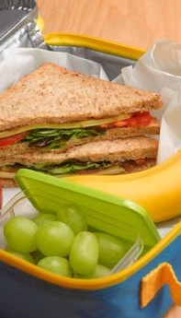
Lunches
These are currently £3 for children. If this price changes then you will be informed.
There is a kitchen on the junior school site and are the same provider as the Infant school, so children are used to the lunches.
Dinners have to be ordered in advance.
School dinners eat in the school hall. Packed lunches eat in the classrooms or in the summer picnic on the playground.

Slide 15


Slide 16
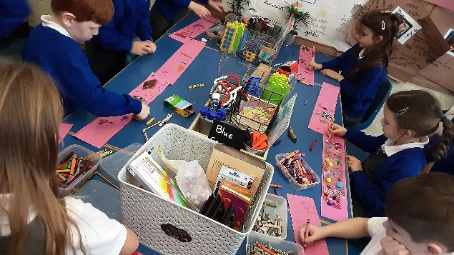
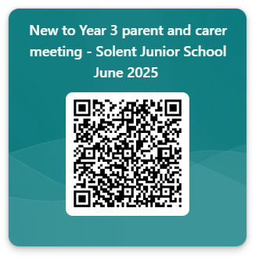
Next Year 3 parent & carer meeting!
There will be more information shared via the ‘New Entrants’ tab on the school website. Please remember to keep an eye on this page as it will continue to be updated.
There will also be a follow up ‘New to Year 3’ parent and carer meeting in September. The class teachers and year group leads will lead the majority of this meeting. A letter will be sent out nearer the time for you to book on to the meeting.
At this point, the Year 3 team will be telling you all about the Year 3 curriculum and associated expectations, the trips, visits and residentials and essential reminders to ensure the Year 3 experience is as positive and successful as possible for your child.

